Slide 1

Mutual Fund Analytics Dashboard
Capstone Project I – Mutual Fund Analytics
Arun Vk · Bluestock Fintech
Data Analyst Internship Program
June 2026

Slide 2
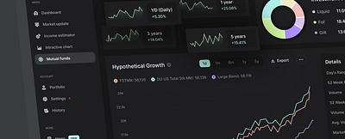
Project Overview
02
The Mutual Fund Analytics Dashboard is an end-to-end financial analytics platform developed using Python, Pandas, SQLite, Scikit-Learn, Plotly, and Streamlit.
The platform enables investors to:
■ Explore mutual fund schemes
■ Analyze performance metrics
■ Assess investment risk
■ Generate personalized recommendations
Data Analytics
Processing and analyzing large-scale mutual fund datasets
Financial Analytics
Calculating CAGR, Sharpe Ratio, and risk-adjusted returns
Dashboard Development
Interactive Streamlit dashboard with real-time filters
Fintech Applications
Practical fintech solution for investment decision support

Slide 3
Problem Statement
03
Challenges Investors Face
Large Number of Available Schemes
Thousands of mutual fund schemes make selection overwhelming for investors
The Need
An automated analytics system capable of generating meaningful insights and personalized recommendations.
Such a system would enable investors to:
Complex Financial Metrics
NAV, expense ratio, Sharpe ratio, and other metrics are difficult to interpret
Manual Comparison is Time Consuming
Comparing funds across multiple parameters manually takes hours of research
■ Make data-driven investment decisions
■ Compare funds efficiently
■ Understand risk profiles
■ Receive tailored recommendations
Risk Assessment is Difficult
Evaluating volatility, drawdown, and VaR requires specialized knowledge

Slide 4
Project Objectives
04
Collect Datasets
Clean & Validate
Store in SQLite
Calculate Metrics
Gather mutual fund data from multiple sources
Process and validate financial data quality
Structured storage for efficient querying
Compute CAGR, Sharpe, Sortino ratios
Analyze Risk
Generate Recommendations
Build Dashboard
Deploy on Cloud
Volatility, drawdown, and VaR analysis
Profile-based fund suggestions
Interactive Streamlit interface
Streamlit Cloud deployment
End-to-End Pipeline
8 Steps
From raw data collection to cloud deployment — a complete analytics workflow

Slide 5
Dataset Description
05
# | Dataset Name | Description
1 | Fund Master Dataset | Core fund information and scheme details
2 | NAV History Dataset | Historical Net Asset Value records over time
3 | AUM Dataset | Assets Under Management tracking data
4 | Monthly SIP Inflows | Systematic Investment Plan contribution data
5 | Category Inflows | Fund category-wise investment flow analysis
6 | Investor Transactions | Individual investor transaction records
7 | Portfolio Holdings | Fund portfolio composition and holdings
8 | Benchmark Indices | Market benchmark data for comparison
Data Processing Pipeline
01 Data Collection from Sources
↓
02 Data Cleaning & Validation
↓
03 Data Transformation
↓
04 Integration into SQLite
All datasets were cleaned, validated, transformed and integrated before analytics processing.

Slide 6
Project Architecture
06
Raw Mutual Fund Data
Data Validation
Data Cleaning
Feature Engineering
Analytics Layer
SQLite Database
Performance Analytics
Risk Analytics
Recommendation Engine
Streamlit Dashboard
The architecture follows a modular pipeline design: Data Ingestion → Processing → Storage → Analytics → Visualization

Slide 7
Technology Stack
07
Programming
Data Processing
Database
■ Python
■ Pandas
■ NumPy
■ SQLite
Machine Learning
Visualization
Dashboard & Deployment
■ Scikit-Learn
■ Plotly
■ Matplotlib
■ Streamlit
■ Git & GitHub
■ Streamlit Cloud

Slide 8
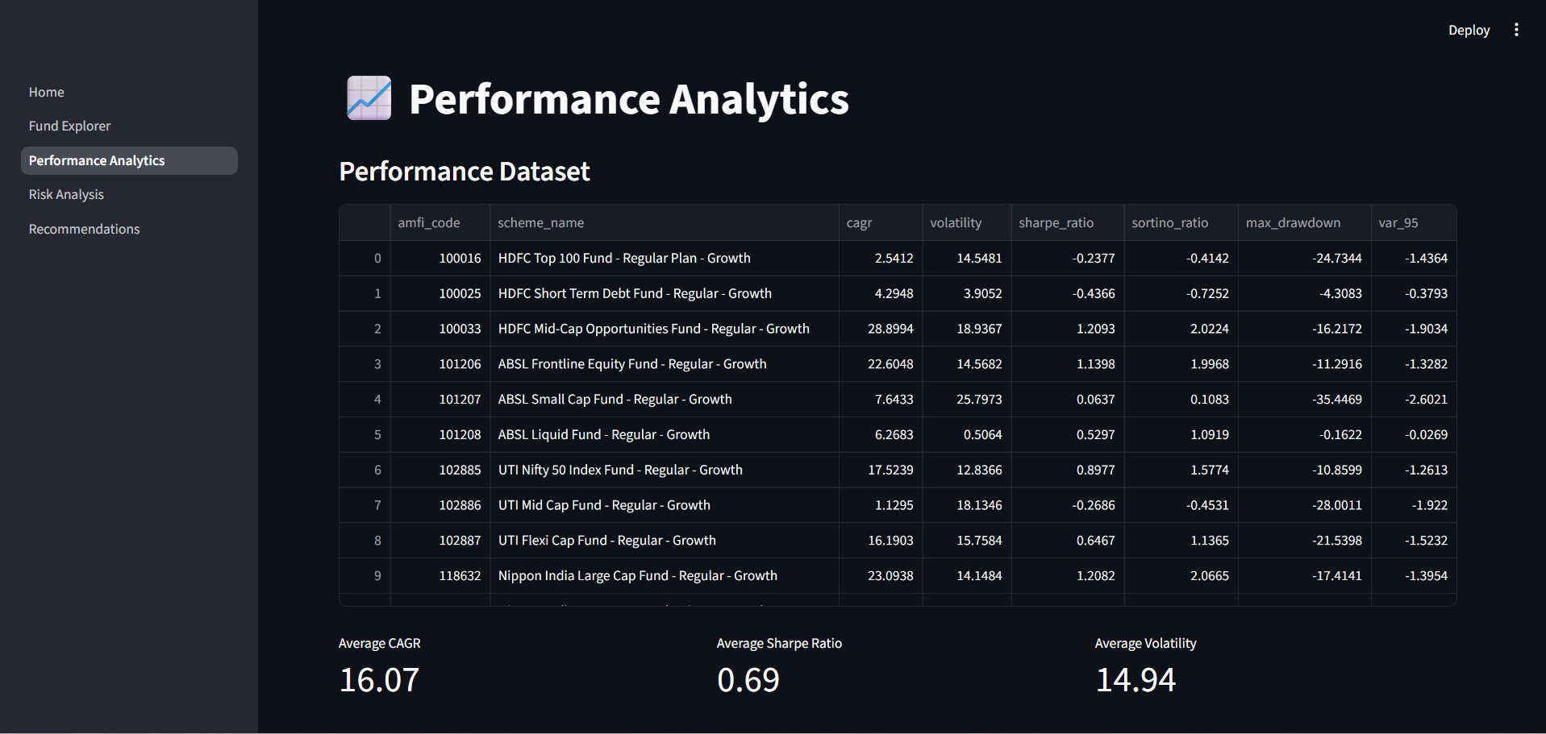
Performance Analytics Module
08
Key Performance Metrics
Performance Analytics Dashboard
CAGR
Compound Annual Growth Rate — measures annualized return over a multi-year period
Sharpe Ratio
Risk-adjusted return metric comparing return to volatility — higher is better
Performance Analytics Dashboard Screenshot
Interactive charts showing fund rankings and returns
Sortino Ratio
Downside risk-adjusted return — focuses only on harmful volatility
Insight: Performance ranking of mutual fund schemes based on historical returns and risk-adjusted performance metrics enables informed investment decisions.

Slide 9
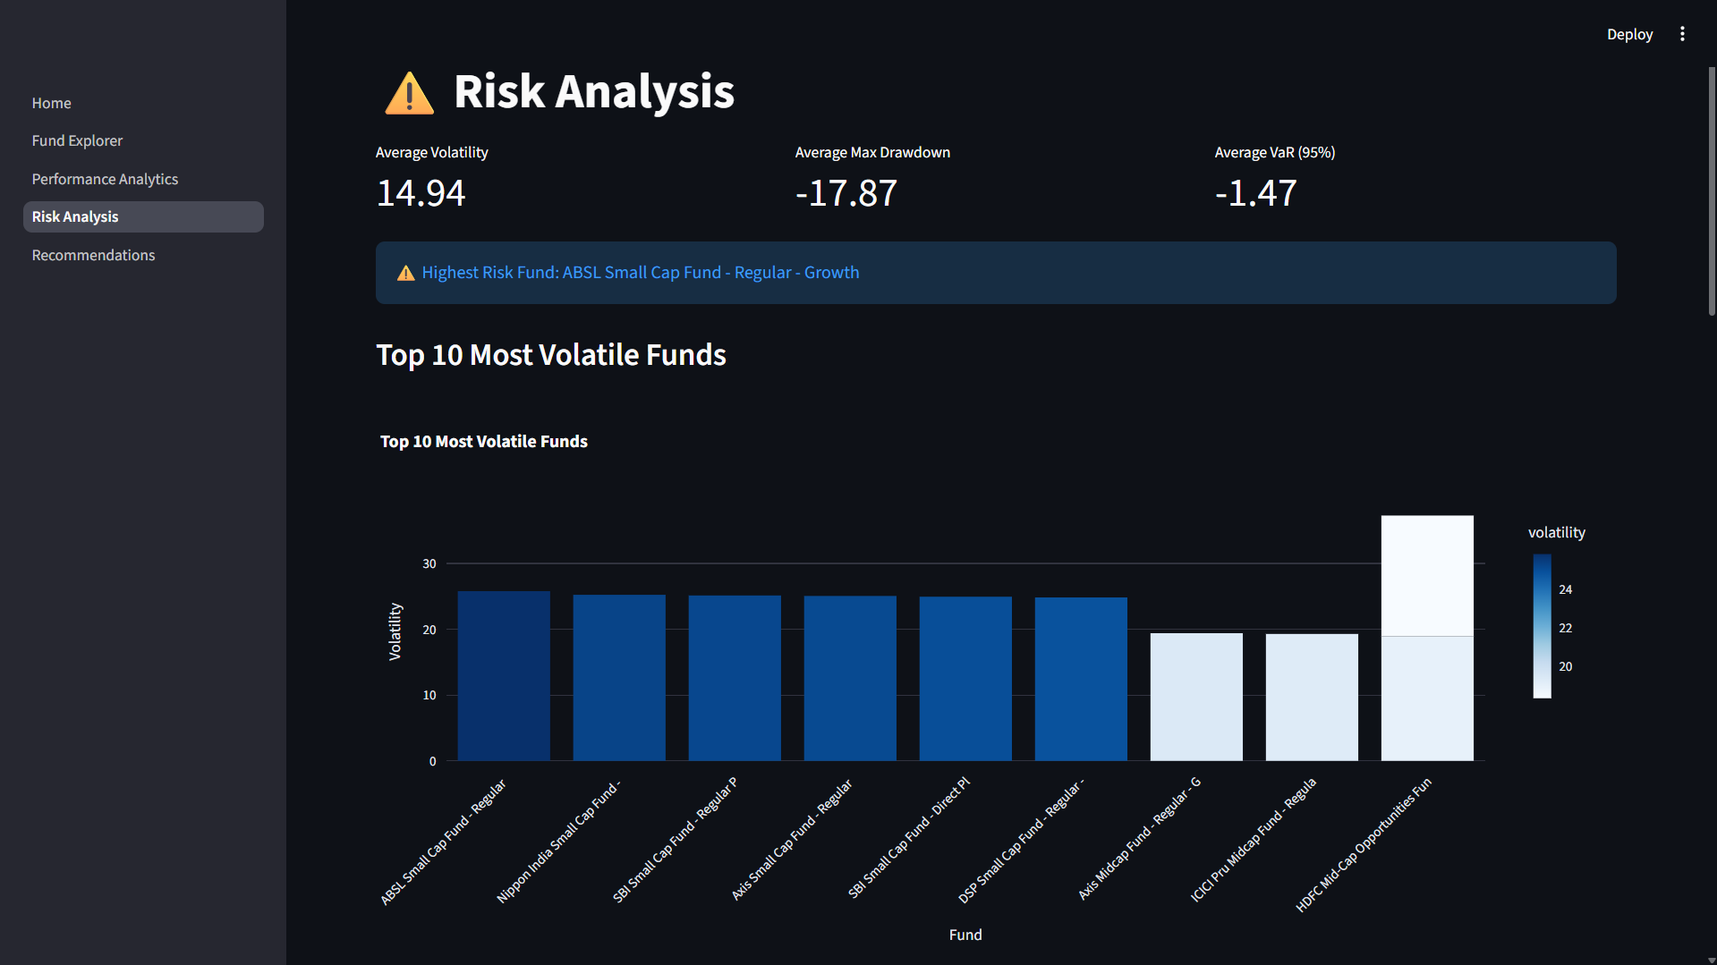
Risk Analysis Module
09
Key Risk Metrics
Risk Analysis Dashboard
Volatility
Standard deviation of returns — measures the degree of variation in fund performance over time
Maximum Drawdown
Largest peak-to-trough decline — indicates the worst-case scenario for investment loss
Risk Analysis Dashboard Screenshot
Visual risk profiling with color-coded indicators
Value at Risk (VaR)
Estimates potential loss at a given confidence level — quantifies downside risk exposure
Insight: The module identifies high-risk and low-risk investment options, enabling investors to align fund selection with their risk tolerance levels.

Slide 10
Recommendation Engine
10
The recommendation engine uses performance and risk metrics to generate suitable fund recommendations based on investor profiles.
Conservative
Moderate
Aggressive
Prioritizes capital preservation with low-risk funds, debt-oriented schemes, and stable returns.
Balanced approach with hybrid funds, moderate risk tolerance, and diversified portfolio.
High growth focus with equity funds, higher risk tolerance, and long-term wealth creation.
■ Low Volatility
■ Debt Funds
■ Stable Returns
■ Medium Volatility
■ Hybrid Funds
■ Balanced Risk-Return
■ High Volatility
■ Equity Funds
■ High Growth Potential
How it works: The engine analyzes fund performance metrics (CAGR, Sharpe, Sortino) and risk indicators (volatility, drawdown, VaR) to match funds with investor risk profiles, generating personalized top fund recommendations.

Slide 11

Key Results & Findings
11
>20%
Strong
Ranked
Profiled
Several funds achieved CAGR greater than 20%
Relationship observed between return and volatility
Risk-adjusted rankings identified high quality funds
Recommendation engine generated profile-based suggestions
Detailed Findings
CAGR Analysis: Multiple equity funds demonstrated CAGR exceeding 20% over a 5-year horizon, significantly outperforming benchmark indices
Risk-Return Correlation: Strong positive correlation observed between historical returns and volatility, validating modern portfolio theory assumptions
Dashboard Impact: The unified analytics dashboard simplified complex fund analysis from hours of manual research to minutes of interactive exploration

Slide 12
Live Dashboard Deployment
12
https://mutualfundanalytics-a5cjfcqbqf5bb9bjydutnb.streamlit.app/
Deployment Features
Cloud Hosted
Interactive Filters
Real-Time Experience
Deployed on Streamlit Cloud with 24/7 availability
Dynamic filtering by category, risk, and returns
Live dashboard updates with instant visual feedback
Download Functionality
Public Accessibility
Export analysis results and fund reports as CSV
Anyone can access the dashboard via web browser
● Dashboard is Live and Accessible | ● Built with Streamlit + Python | ● Deployed June 2026 | ● Github Repository

Slide 13
Future Enhancements
13
Live Mutual Fund APIs
PostgreSQL Migration
Portfolio Optimization
Real-time data feeds from AMFI and other financial data providers
Scalable database solution for handling larger datasets
Modern Portfolio Theory based optimal allocation suggestions
Monte Carlo Simulations
Advanced ML Recommendations
Automated Reports
Probabilistic return forecasting using simulation models
Collaborative filtering and content-based recommendation models
Scheduled PDF and email report generation for portfolios
Mobile Responsive Design
Fully responsive dashboard design optimized for mobile and tablet devices, enabling on-the-go fund analysis and portfolio monitoring.

Slide 14
Conclusion
14
The project successfully combines data analytics, financial analytics, database management, machine learning, and dashboard development into a unified mutual fund analytics solution.
Practical Fintech Application
Data-Driven Decisions
Successful Deployment
Real-world financial analytics solution for investment decision-making
Empowers investors with quantitative insights and recommendations
Live cloud deployment with public accessibility and interactive features
This capstone project demonstrates proficiency in the complete data analytics pipeline — from data collection and processing to machine learning and cloud deployment — delivering a production-ready fintech analytics solution.

Slide 15

Thank You
Questions & Discussion
Arun Vk
Mutual Fund Analytics Dashboard
Bluestock Fintech · Data Analyst Internship Program · June 2026

